Slide 1
Crop Production Analysis
By: Anieruth s

Slide 2
01
Introduction
This analysis examined crop production data from 1997 to beyond 2012.

Slide 3
Production Over Time: A Story of Fluctuations
Crop production exhibits significant fluctuations throughout the analyzed period.
These variations are likely influenced by:
Weather patterns (droughts, floods)
Technological advancements (improved seeds, irrigation methods)
Economic factors (market demand, input costs).
There are significant ups and downs over time. These fluctuations can be attributed to various factors. Weather plays a major role – droughts and floods can significantly impact yields. Technological advancements, such as the introduction of improved seeds and irrigation methods, can lead to production increases. Finally, economic factors like market demand and the cost of inputs can also influence production decisions.

Slide 4
Seasonal Variations
Production levels vary significantly across seasons:"Whole Year" – Highest variation, indicating year-round output for specific crops.
"Kharif" – Substantial variation, suggesting seasonal dominance for certain crops.
"Autumn," "Rabi," "Summer," "Winter" – Generally lower production levels.

Slide 5
Seasons and Their Influence
The season plays a crucial role in crop production. Here, we see how production levels vary across different seasons.
The "Whole Year" category shows the highest variation, indicating crops grown year-round.
The "Kharif" season, typically associated with monsoon rains in India, also displays substantial variation, suggesting crops that thrive during this time.
Production levels are generally lower in other seasons like Autumn, Rabi (winter sown crops harvested in spring), Summer, and Winter.
Understanding these seasonal variations is vital for informed crop selection and resource allocation throughout the year.

Slide 6
02
Production
Analysis about the production of crops

Slide 7
Rice Production: A Spike of Promise
Rice production exhibits a relatively stable trend with some fluctuations.
A sharp increase is observed around 2012.
Potential reasons for the increase:
Improved agricultural practices
Technological advancements
Favorable weather conditions
Rice is a staple food crop in many regions. Here, we see rice production following a relatively stable trend with some variations. Interestingly, there's a sharp increase observed around 2012.5. This rise could be attributed to several factors, such as the adoption of improved agricultural practices, advancements in rice cultivation technologies, or perhaps even favorable weather conditions during that period. Further investigation into this specific increase can provide valuable insights for replicating the success in other regions.

Slide 8
Geographic Spotlight: Leaders and Laggards
East Godavari district emerges as the leader in crop production within the analyzed region (2006-2012).
Kadapa district is likely among those with the lowest production.
Further analysis is needed to understand the underlying reasons for these disparities.
When we delve into specific geographic locations, we can identify leading and lagging producers. Here, the analysis reveals East Godavari district as the leader in crop production within the region we examined for the period 2006-2012. Conversely, Kadapa district appears to be among those with the lowest production levels. To understand these disparities better, further analysis is needed. This could involve investigating factors like soil quality, irrigation infrastructure, access to technology, and government support programs in each region.

Slide 9
Most Dominant Crop
1997
2005
2010
2012
Coconut
Coconut
Coconut
Coconut
We observe a that the dominant crop from the year 1997 to 2012 is “Coconut”.

Slide 10
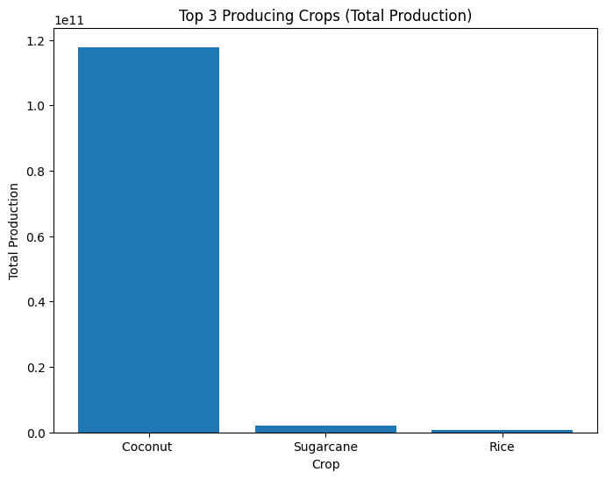
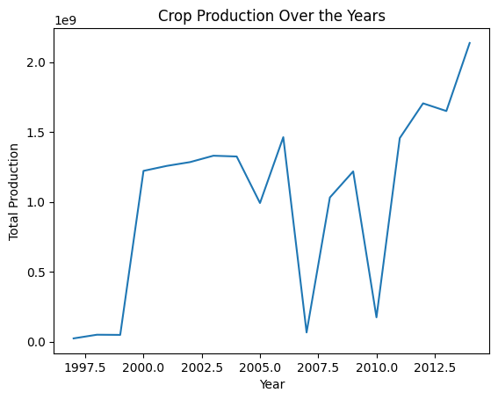
Data Analysis Visualizations

Slide 11
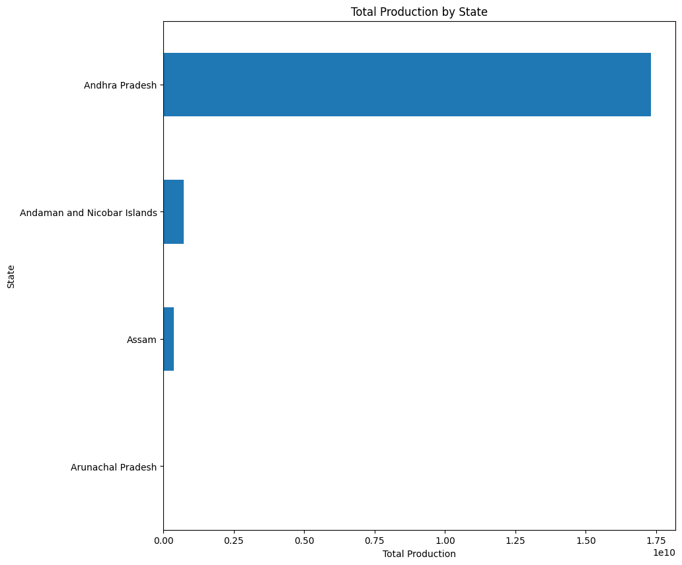
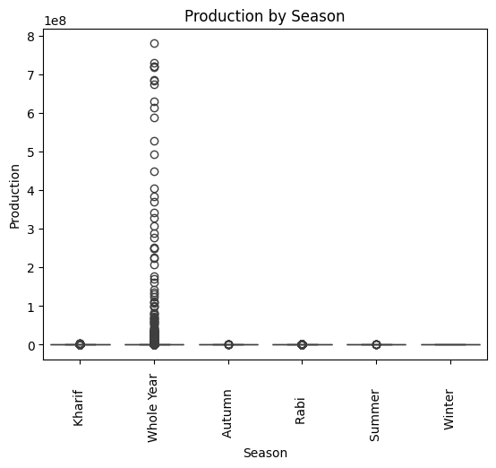
Data Analysis Visualizations

Slide 12
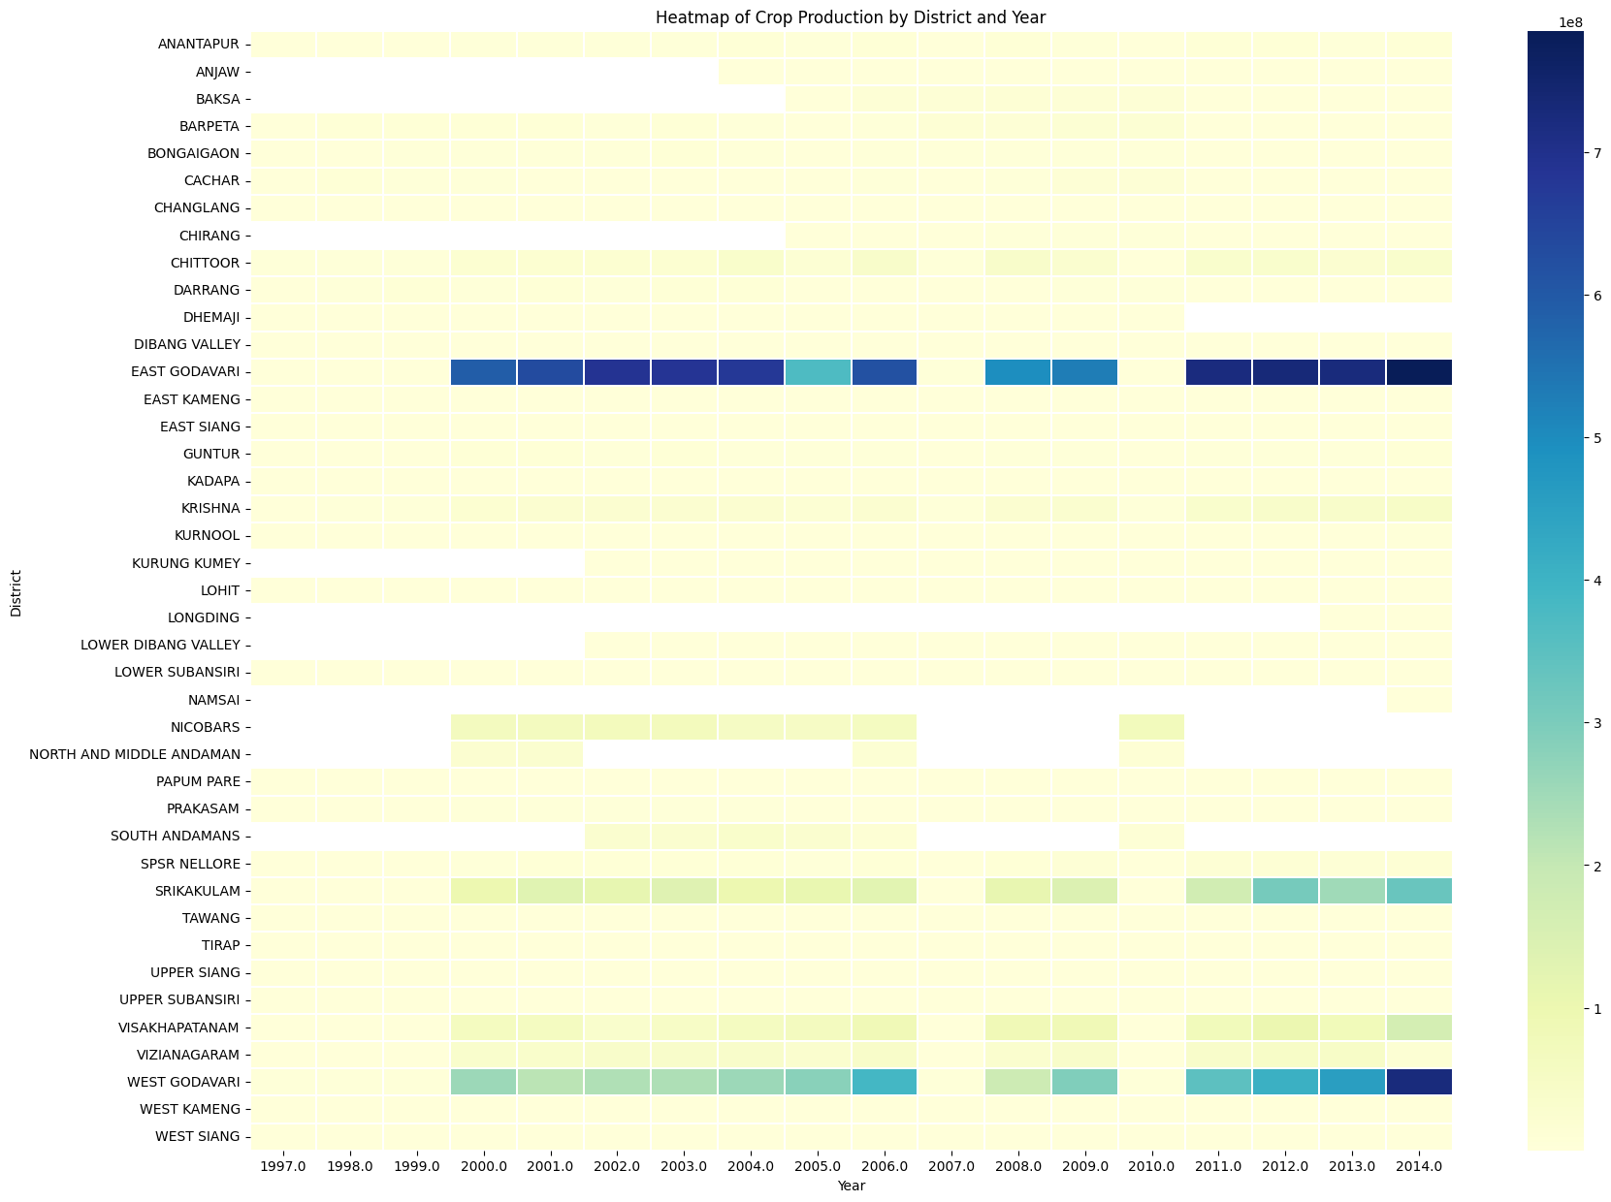
Data Analysis Visualizations

Slide 13
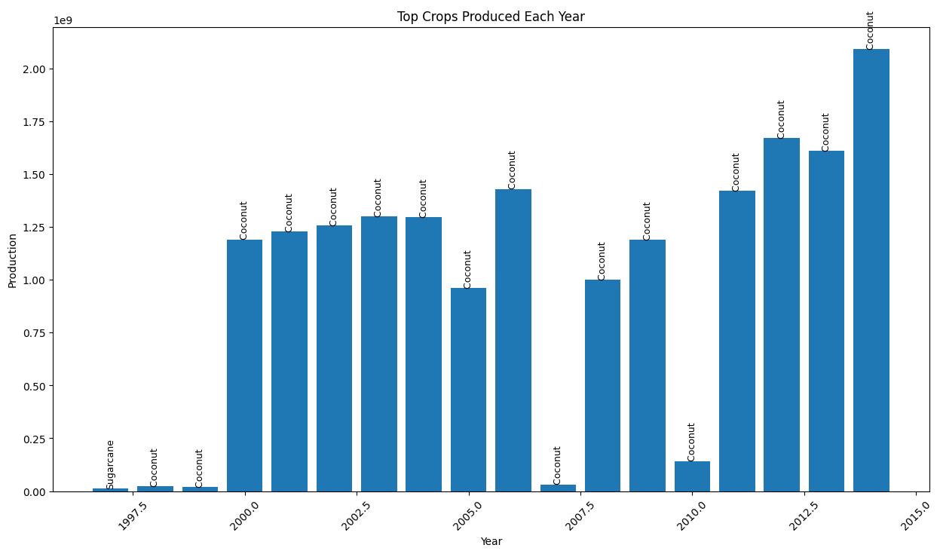
Data Analysis Visualizations

Slide 14
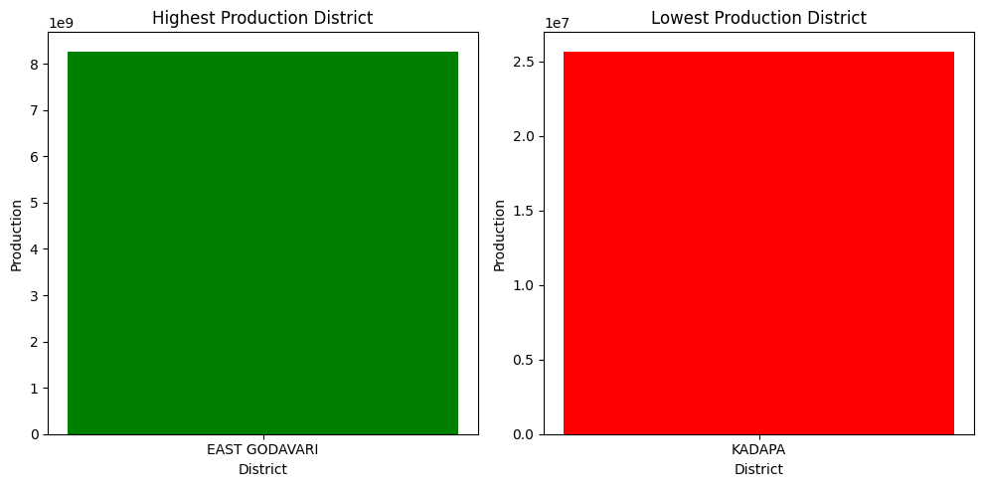
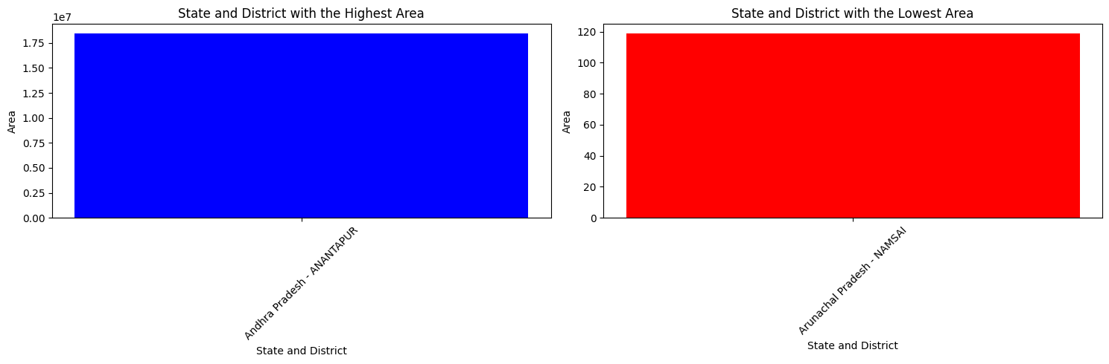
Data Analysis Visualizations

Slide 15
Thank You

